Slide 1
Teaching World Languages in Steiner/Waldorf Schools
The “Three-Fold Lesson” Approach:
Slideshow and presentation by Kim Napa, Spokesperson for the Leadership Team of the Waldorf Spanish Teachers Association

Slide 2
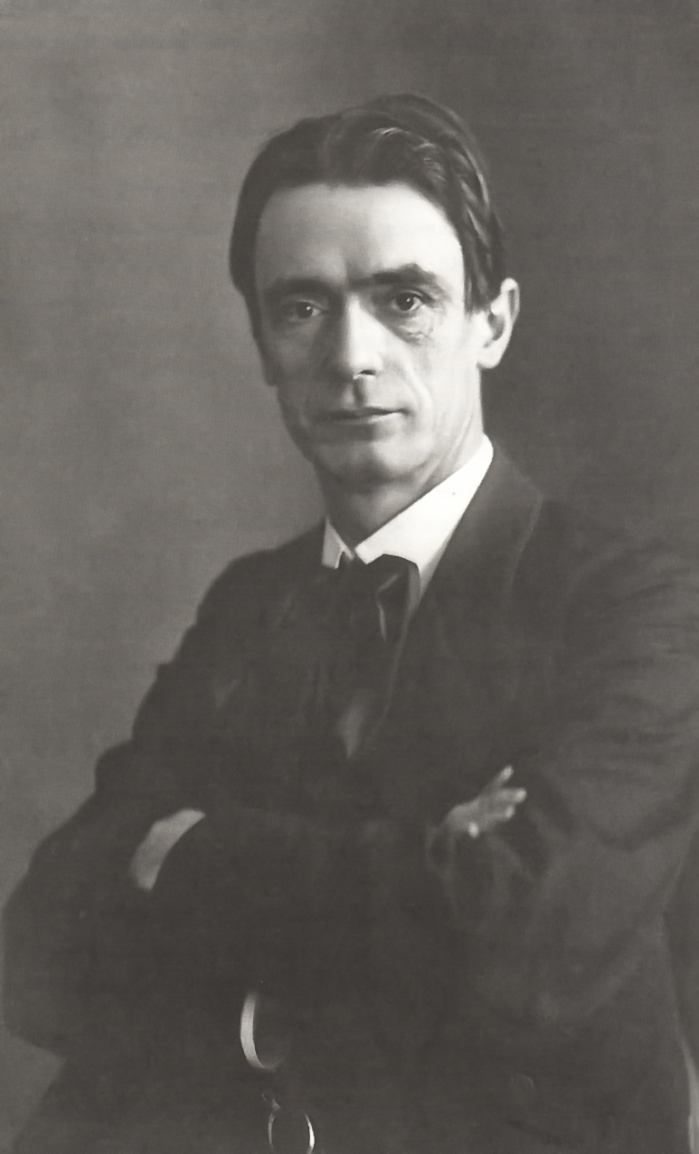
Rudolf Steiner:
1861-1925

Slide 3
Rudolf Steiner:
1861-1925
Austrian philosopher, architect, scientist, educator and lecturer,on social reform
Founded Anthroposophy: “Wisdom of the Human Being”
Developed Waldorf Education, Biodynamic Agriculture and Anthroposophic Medicine
First Waldorf school-1919 in Germany
Currently over 1000 Waldorf or Steiner schools in 60 countries; additionally, over 1800 Waldorf kindergartens in 70 countries

Slide 4
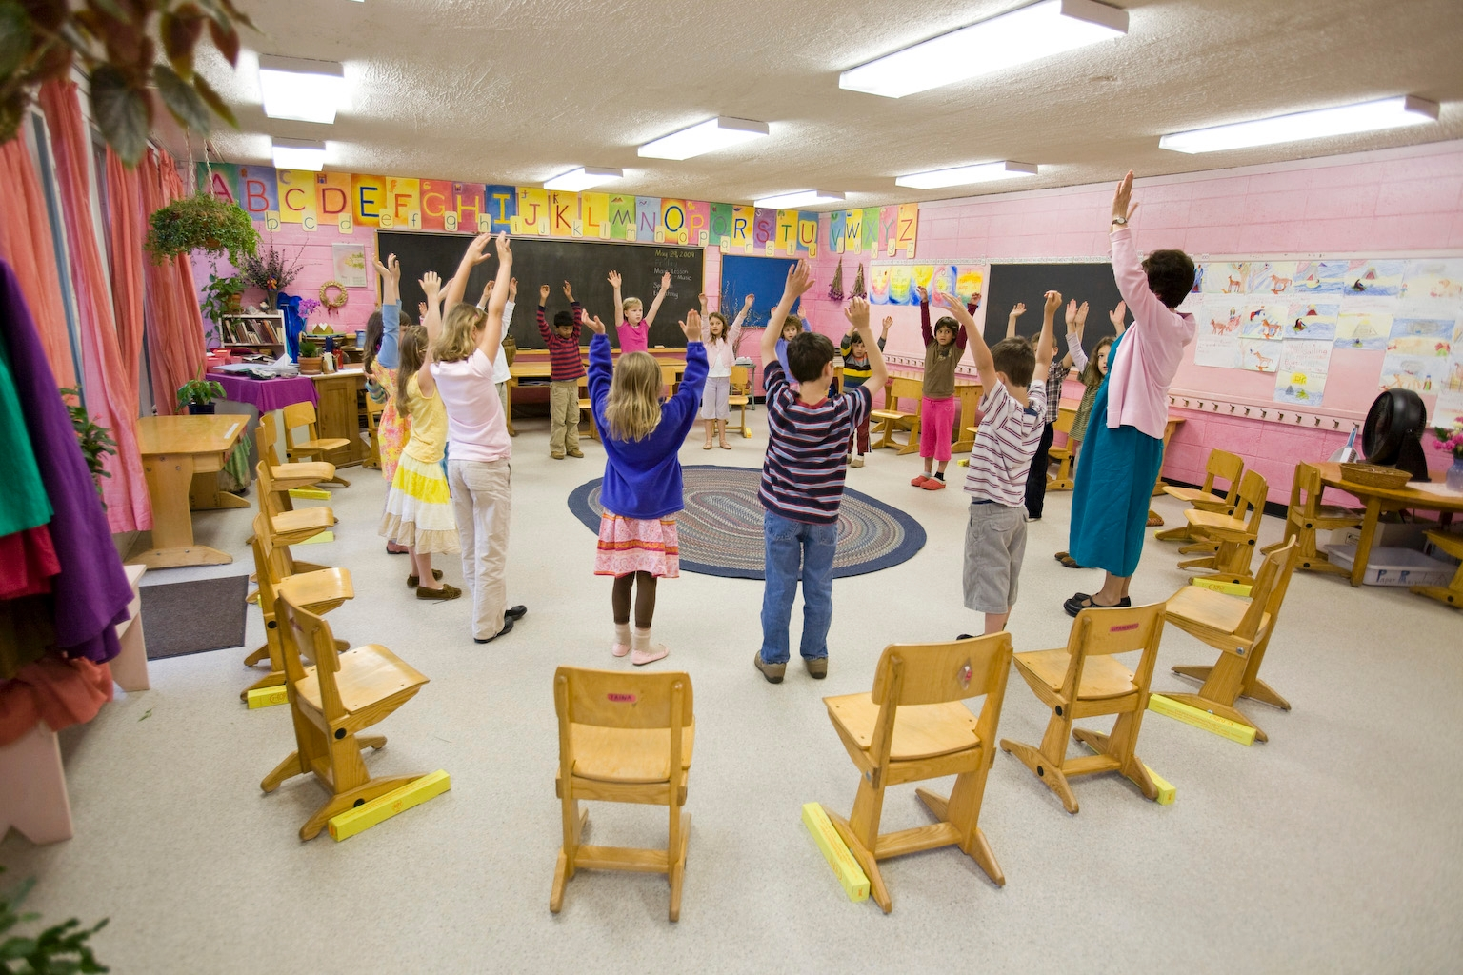
Waldorf Schools Steiner Schools
“Accept the children with reverence,
educate them with love,
send them forth in freedom."

Slide 5
Waldorf Schools “Accept the children with reverence, Steiner Schools
educate them with love,
send them forth in freedom."
Holistic and integrated education; cross-curricular; immersive/thematic approach
Developmentally- appropriate curriculum
Move from the whole to the part
Reach the intellect through the feelings
Bring a sense of beauty, reverence and love through an artistic approach
Cultivate independent thinking and imagination, and develop strength of will
Student created lesson books
Teacher training includes support of social- emotional learning
Teach out of freedom to meet child’s needs
Focus on “whole child” development: heart/head/hand

Slide 6
Educating all aspects of the whole child in a developmentally or age appropriate way to meet
Head, Heart, Hand

Slide 7
Educating all aspects of the whole child in a developmentally or age appropriate way to meet
Head, Heart, Hand
In Waldorf Education we refer to these aspects as
Thinking, Feeling, Willing

Slide 8
Educating all aspects of the whole child in a developmentally or age appropriate way to meet
Head, Heart, Hand
In Waldorf Education we refer to these aspects as
Thinking, Feeling, Willing
In striving to meet all of these aspects in each and every lesson, the Waldorf teacher works out of the
The Three-Fold Lesson Approach

Slide 9
How do we bring this
unique approach
into the language classroom?
No matter which of the wide variety of languages taught in Waldorf schools……

Slide 10
Underlying objectives in the world language curriculum in Waldorf Schools:
Cultivating Empathy,
Interest in Others,
Social Consciousness

Slide 11
Underlying objectives in the world language curriculum in Waldorf Schools:
Cultivating Empathy,
Interest in Others,
Social Consciousness
Encountering the ‘otherness’ of a new language helps cultivate better self-understanding

Slide 12
Underlying objectives in the world language curriculum in Waldorf Schools:
Cultivating Empathy,
Interest in Others,
Social Consciousness
Encountering the ‘otherness’ of a new language helps cultivate better self-understanding
World language studies aim to foster ‘social pedagogy’

Slide 13
Underlying objectives in the world language curriculum in Waldorf Schools:
Cultivating Empathy,
Interest in Others,
Social Consciousness
Encountering the ‘otherness’ of a new language helps cultivate better self-understanding
World language studies aim to foster ‘social pedagogy’
Through stories and cultural lessons the child recognizes humanity across cultures with diverse views

Slide 14
Underlying objectives in the world language curriculum in Waldorf Schools:
Cultivating Empathy,
Interest in Others,
Social Consciousness
Encountering the ‘otherness’ of a new language helps cultivate better self-understanding
World language studies aim to foster ‘social pedagogy’
Through stories and cultural lessons the child recognizes humanity across cultures with diverse views
Lead the child toward empathy and heightened social conscience through the cultural lessons
Cultivate joy and a love of learning languages that leads the students to a sense of being global citizens

Slide 15
How do we bring this
unique approach
into the language classroom?
Creating developmentally appropriate lesson plans, founded in these objectives, and incorporating the three elements of
Thinking, Feeling, Willing

Slide 16
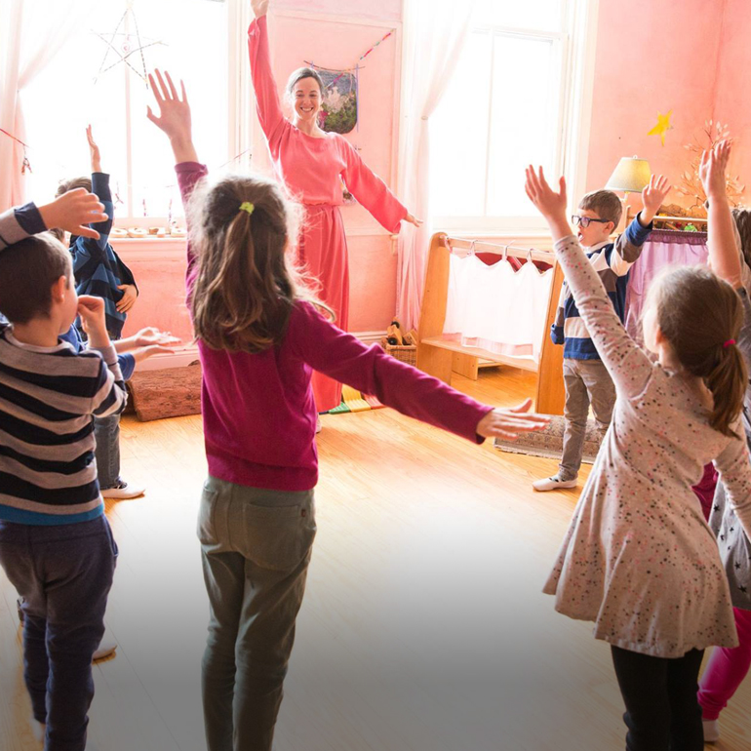
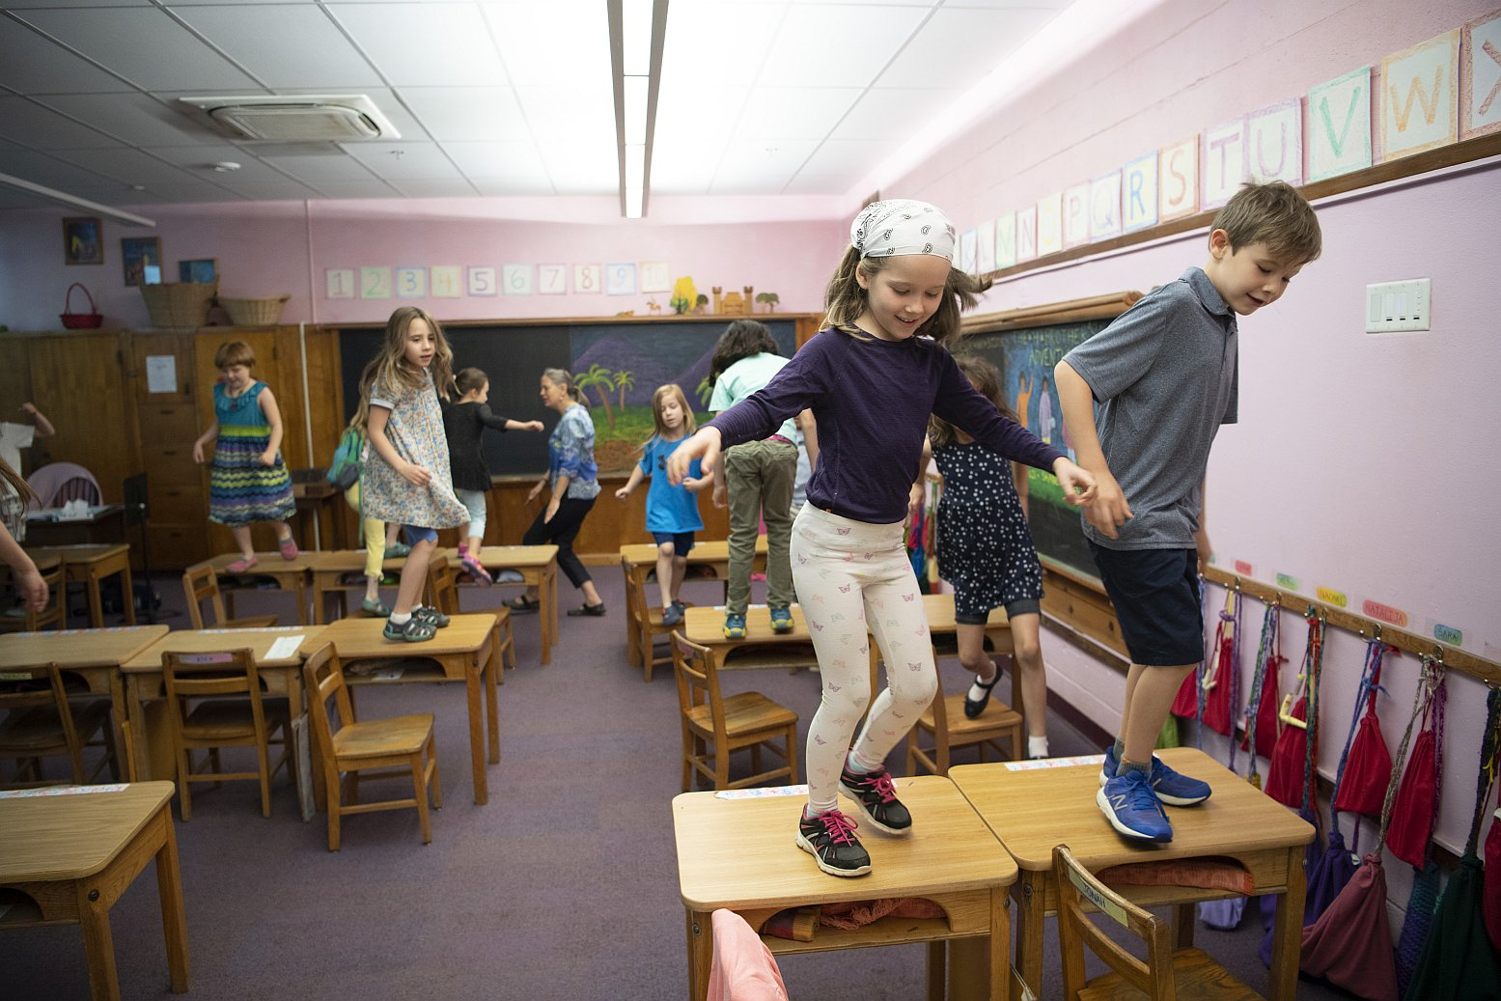
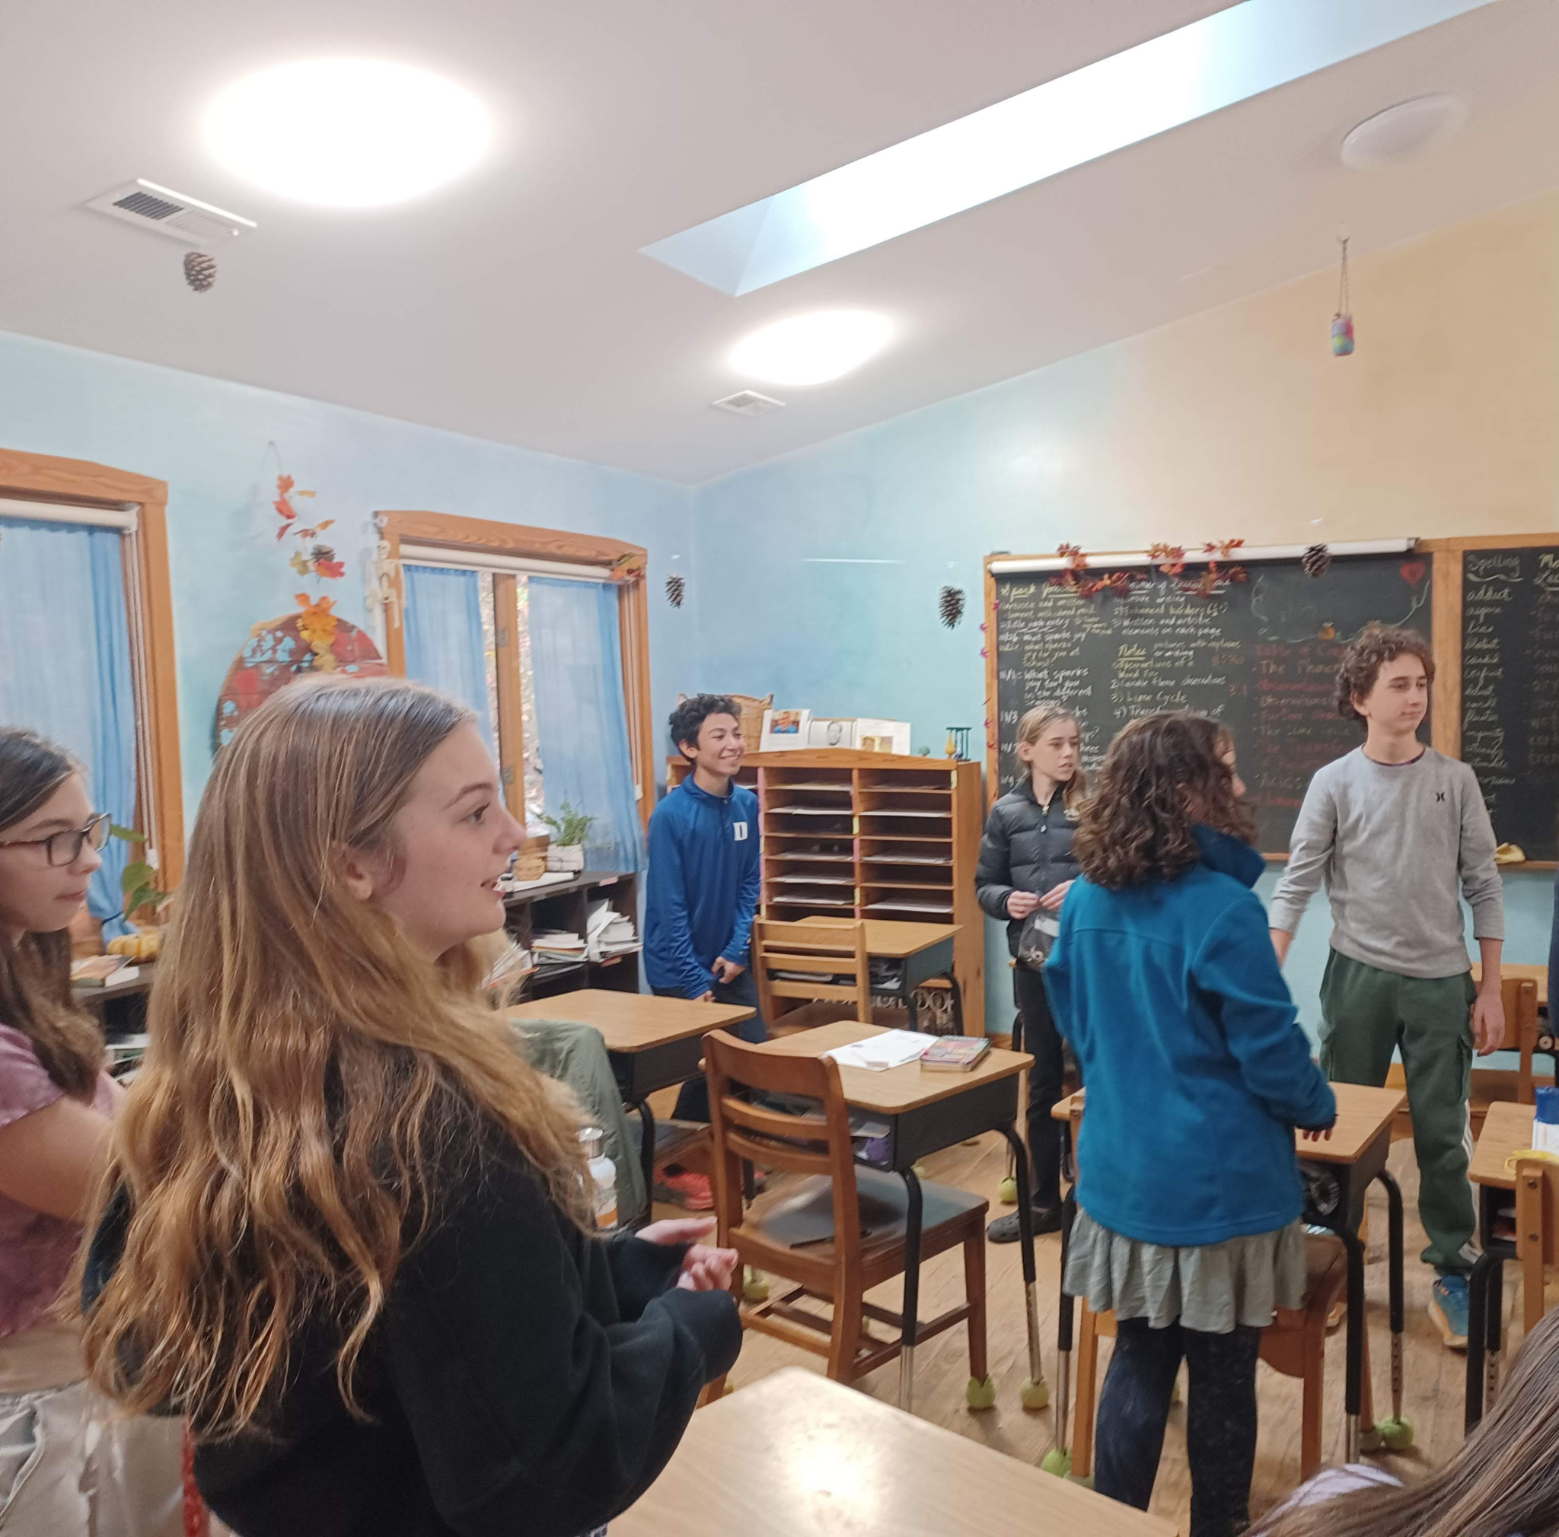
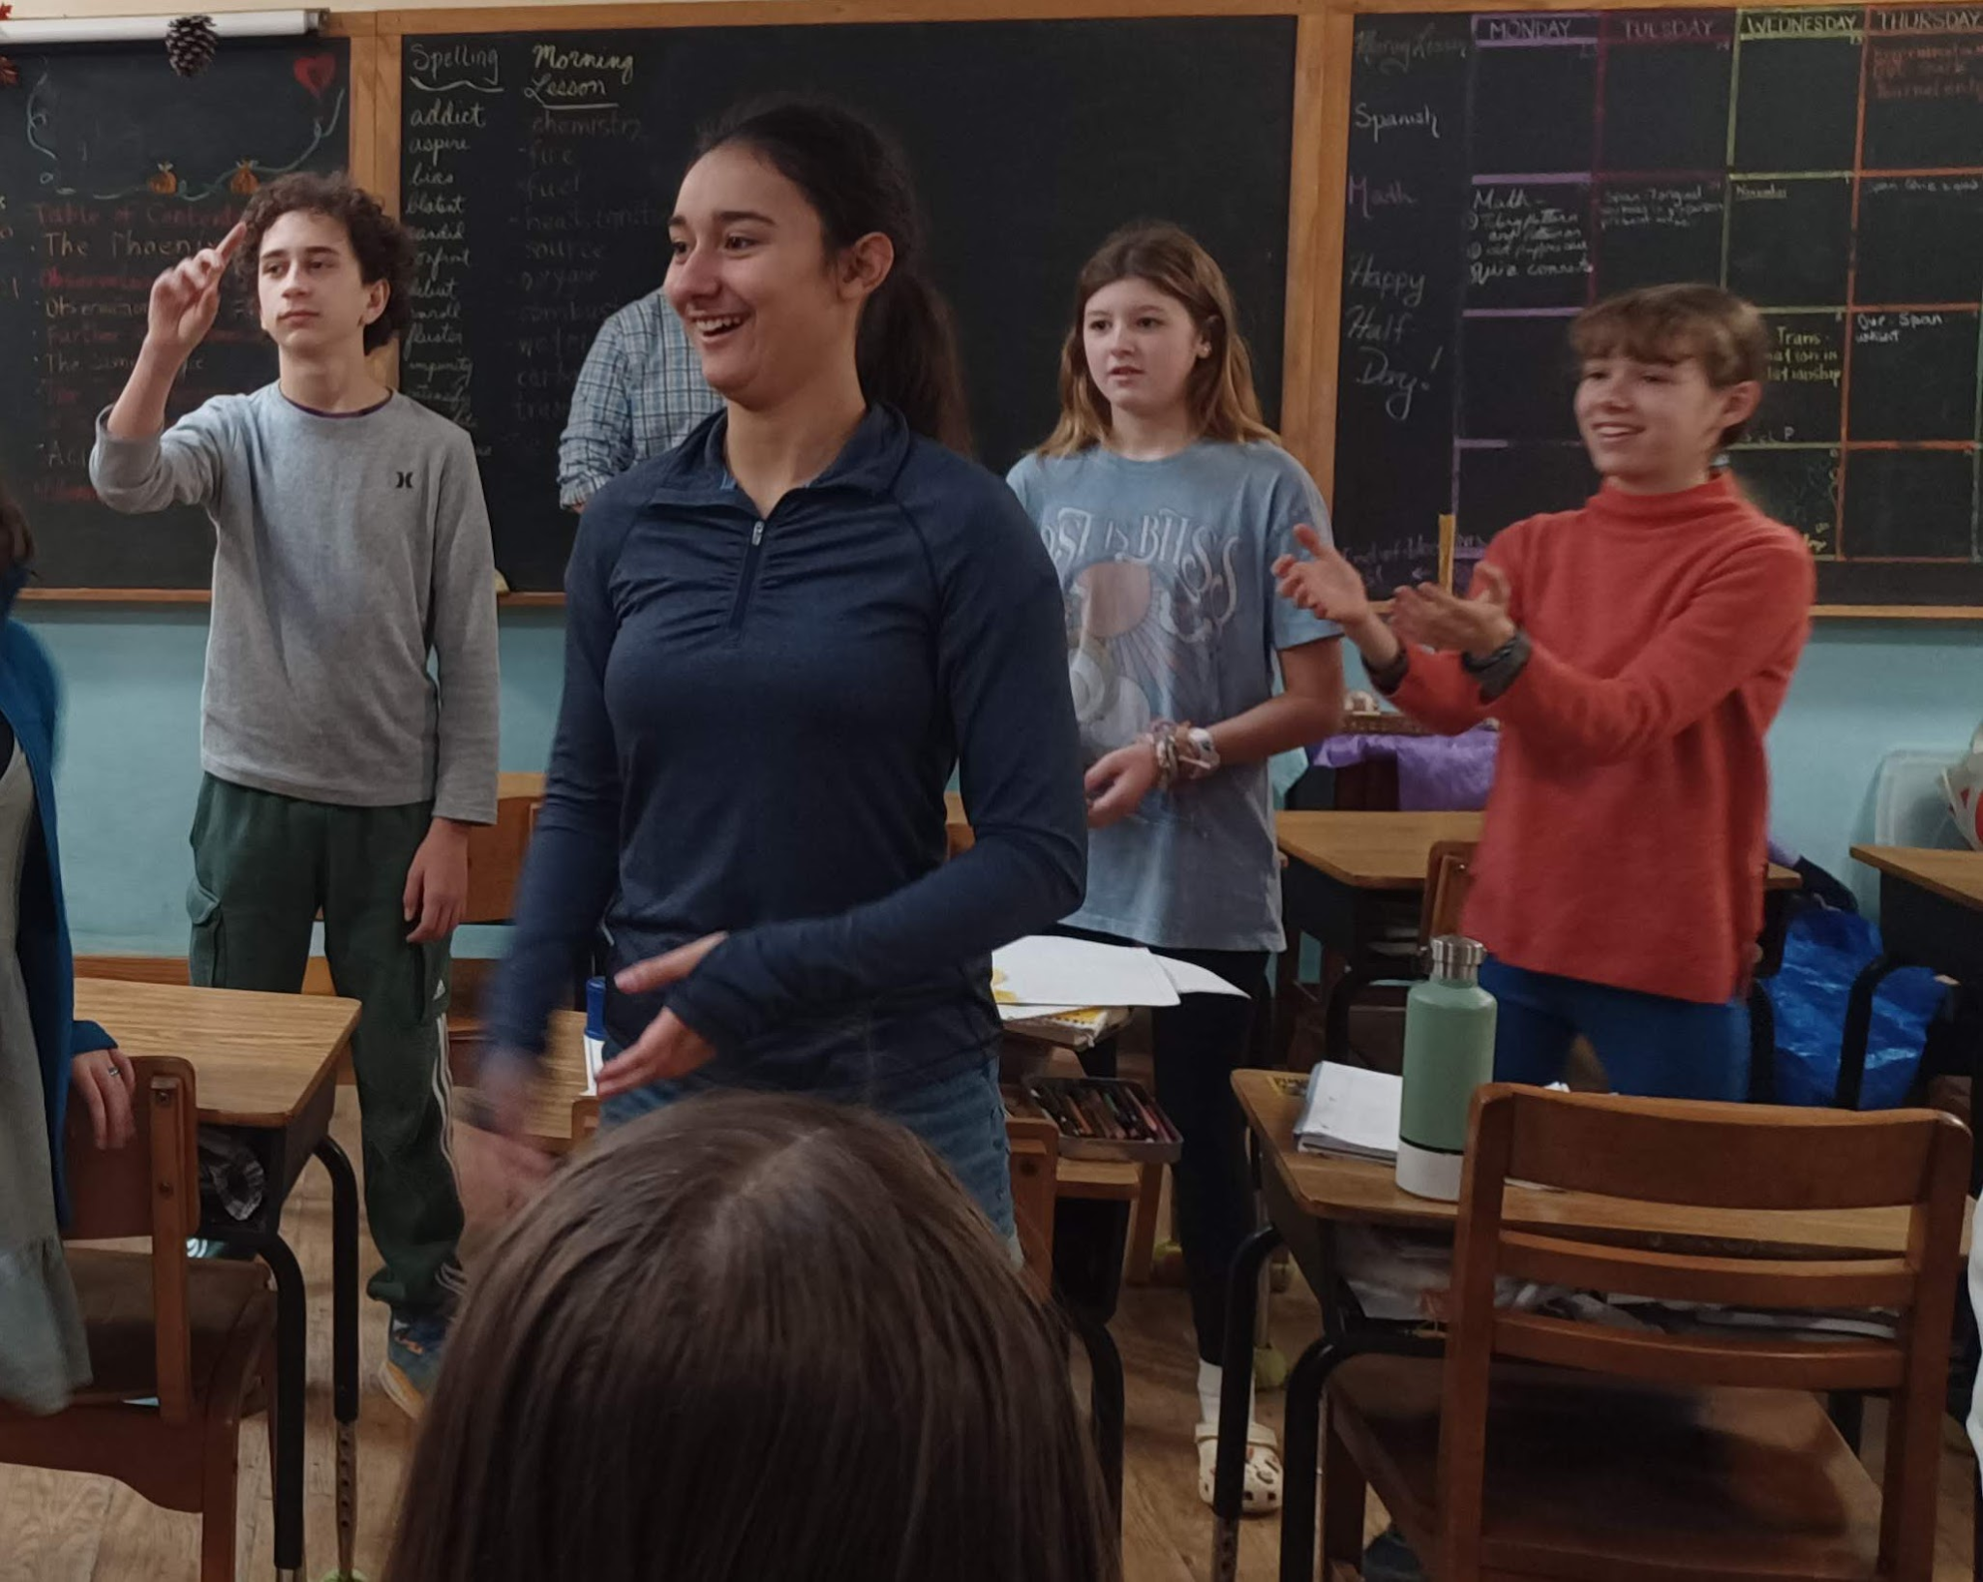
Feeling: (approx 5-10 minutes, depending on age)
Whole class participates in rhythmic warm up
Reconnects with teacher and language through song and verse; feeling the sounds, cadence, rhythm of language in culturally authentic material (ie. folk songs, rhymes)
Kinesthetics connected to auditory/visual helps facilitate memory, joy of learning
Recapitulation of last lesson to prepare for new content
Conversational exercises, vocabulary games,

Slide 17
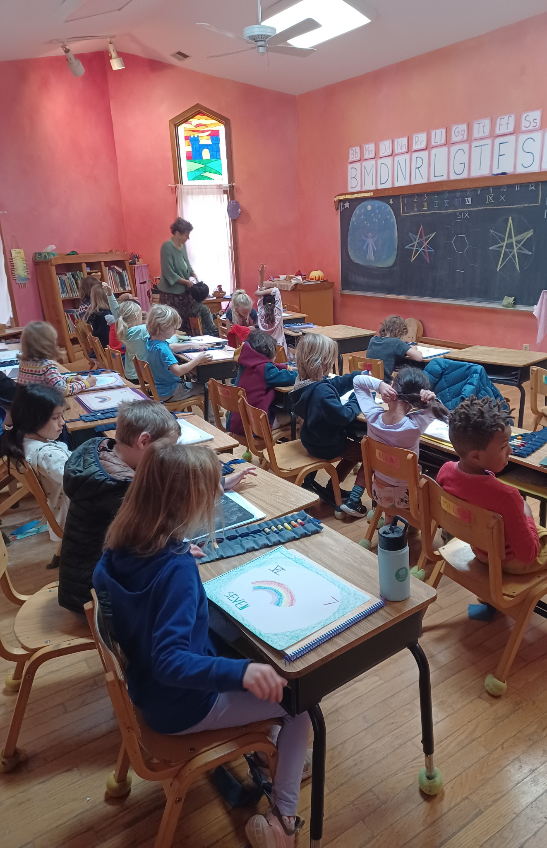
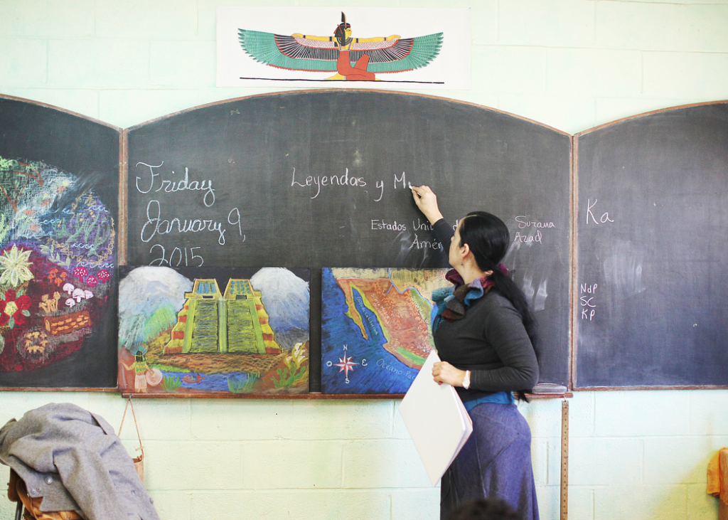
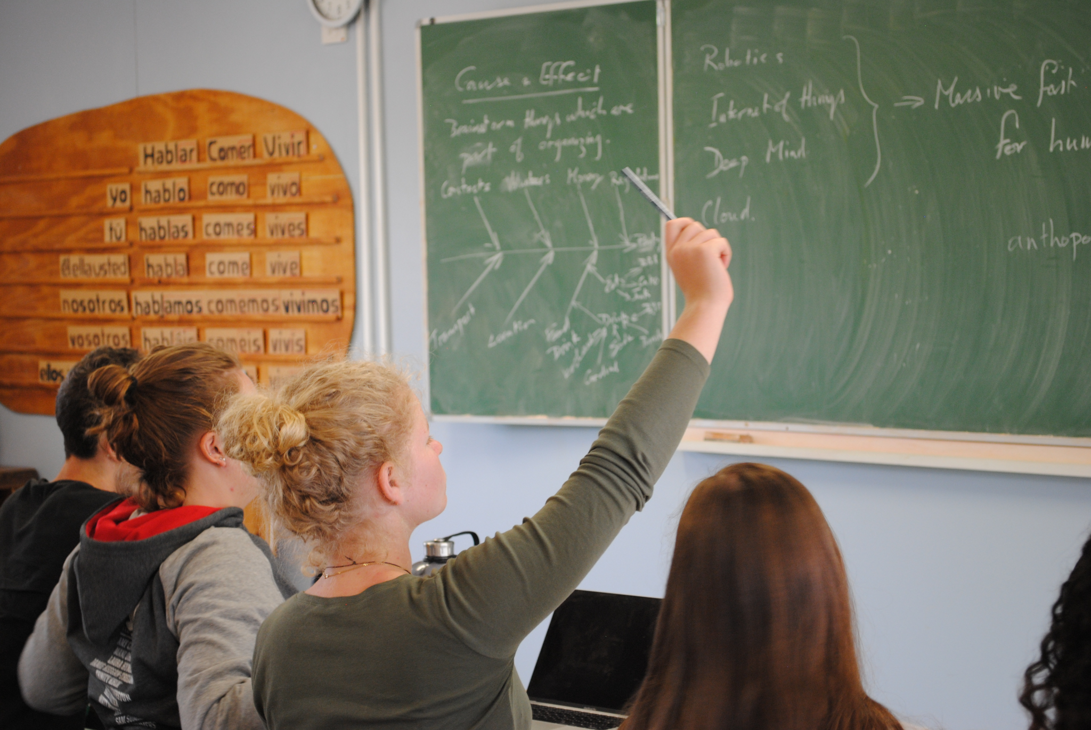
Thinking: (approx 20 minutes)
Vocabulary exercises-good transition from feeling to thinking
New content–hearing stories, poetry, grammar concepts
Active listening exercises
Creating original sentences – oral and written
Reading, group and individual- to improve fluency, rhythm and pronunciation

Slide 18
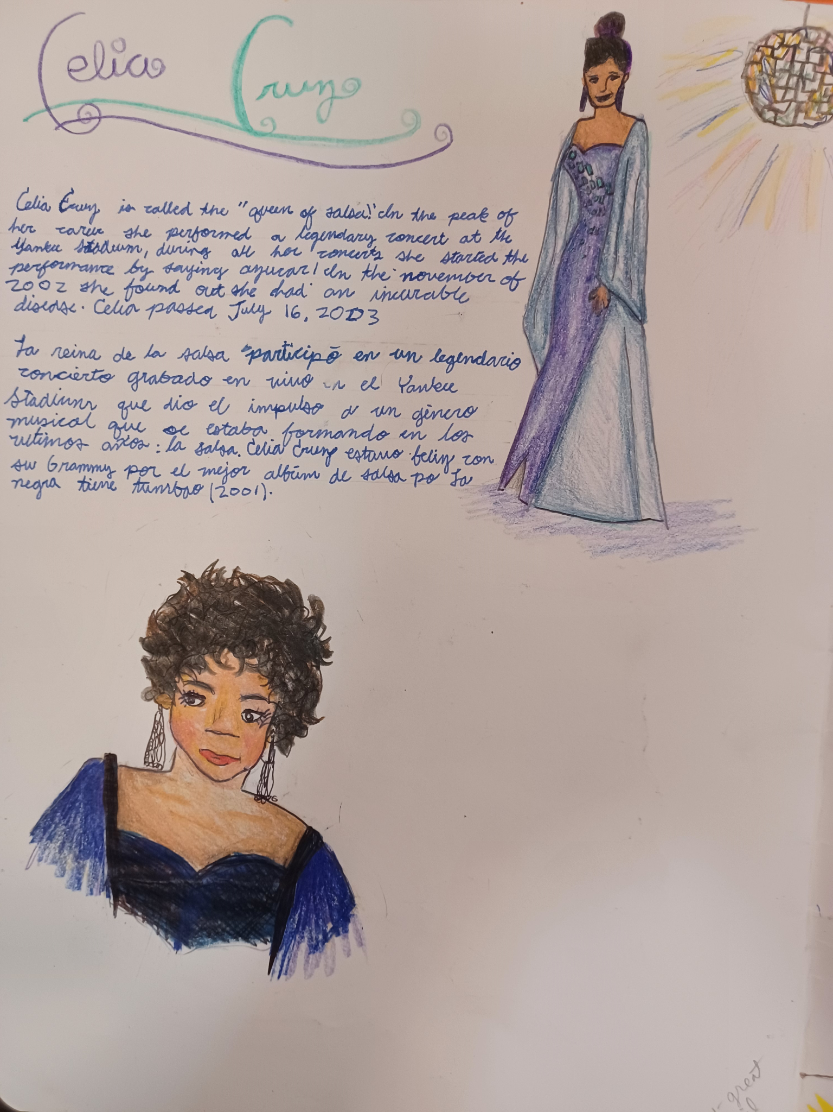
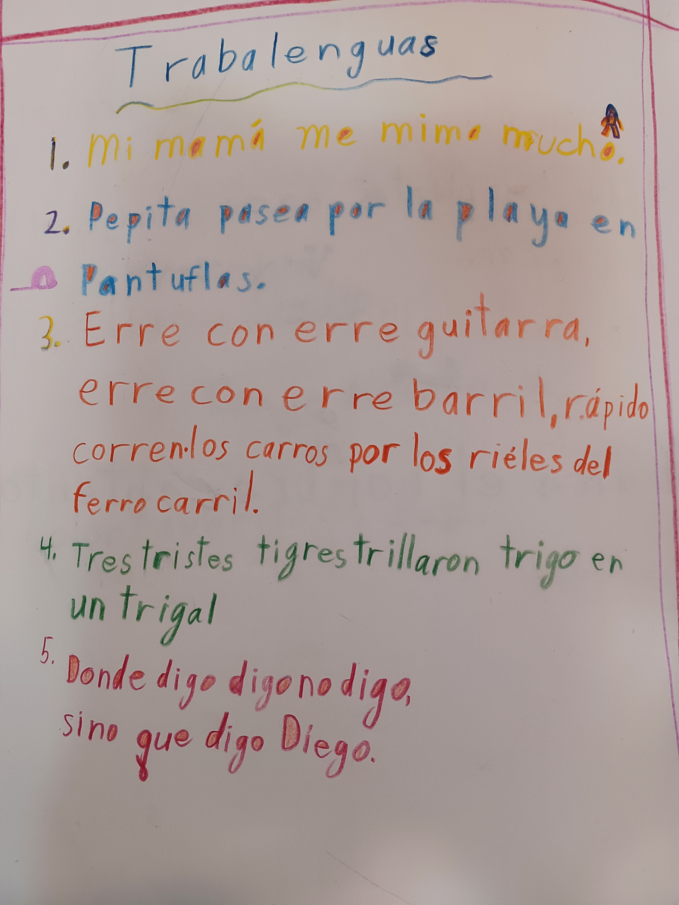
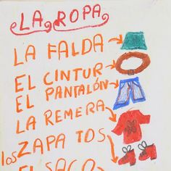
Willing: (approx 10-20 minutes)
Practice what has been learned
Deepen one’s connection to the content
Weave various aspects of the language together
Write, illustrate, recreate, individual work
Start homework assignment

Slide 19
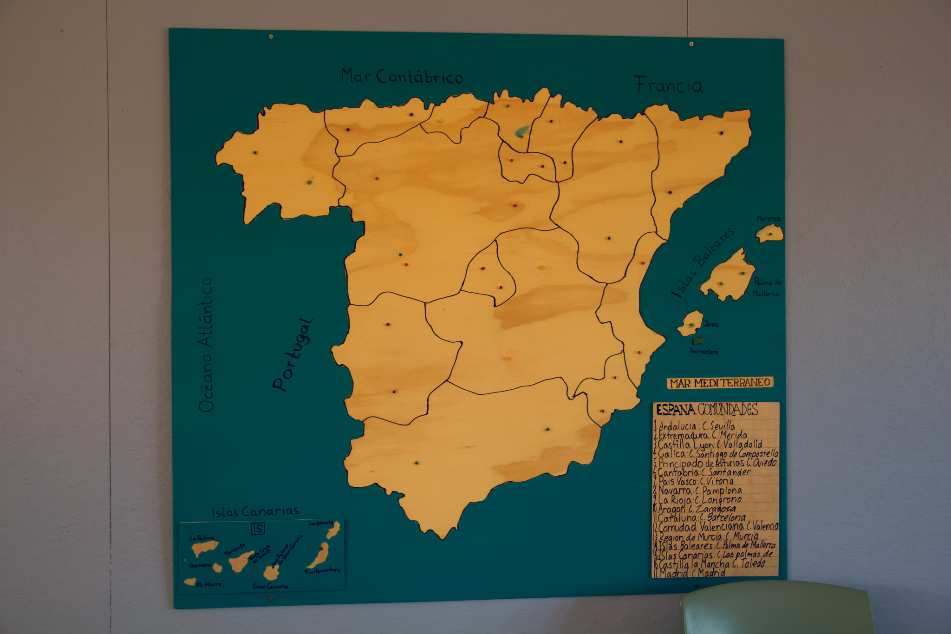
Reach the intellect through the feelings

Slide 20
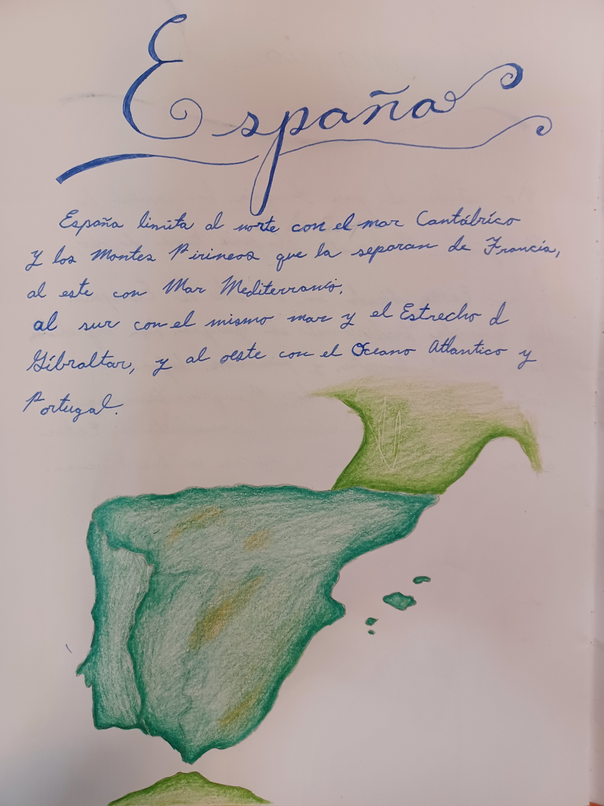
Reach the intellect through the feelings
Bring the lesson content in an artistic
manner

Slide 21
Examples of the “Three Fold Approach” in the middle grades of 4th-5th

Slide 22
Examples of the “Three Fold Approach” in the middle grades of 4th-5th:
“Feeling:”
(10 m)
Rhythmic Warm-up
Greetings, Opening verse, Review song (just for the joy of singing and warm-up)
New song being practiced (perhaps line by line, or focus on a particular aspect such as “raise your hand everytime we sing the word ‘birds’”, or “clap with me on each noun”) Always end with returning to the whole song in original form
Number review/drill with clapping patterns (alone or with partner), or a quick ABC drill, perhaps with passing a bean bag to the next person to say a letter

Slide 23
Examples of the “Three Fold Approach” in the middle grades of 4th-5th:
“Thinking”:
(15-20 min)
Concentration
New content
Students transition from warm up to new content with conversation using target vocabulary: Show pictures of animals and describe: Color, size, habitat, food, characteristics, etc
Introduce an easy animal riddle (elephant) through description, have children guess before seeing picture
Write the example on the board, practice reading out loud together

Slide 24
Examples of the “Three Fold Approach” in the middle grades of 4th-5th:
“Willing”:
(10-20 min)
Practice
Write and/or illustrate
Play a quick game for transition: “Breathing” into the rhythm of the lesson, capture any child losing attention. Example: “Simon Says…”
Children take out pencils and language books
Teacher example is copied from the board.

Slide 25
Examples of the “Three Fold Approach”
in the middle grades
of 4th-5th:
What was the “will” work of writing in one lesson can become the warm-up/ review aspect of the following day in guessing games
Transitions between activities may include: more movement, quick concentration games
A rhythm is woven between each of the segments of the lesson to create a healthy “breathing” that supports class management, student engagement
Considerations for upcoming lessons:
What was new content in the main body of the lesson one day can become the practice and writing of the “will” work the following day

Slide 26
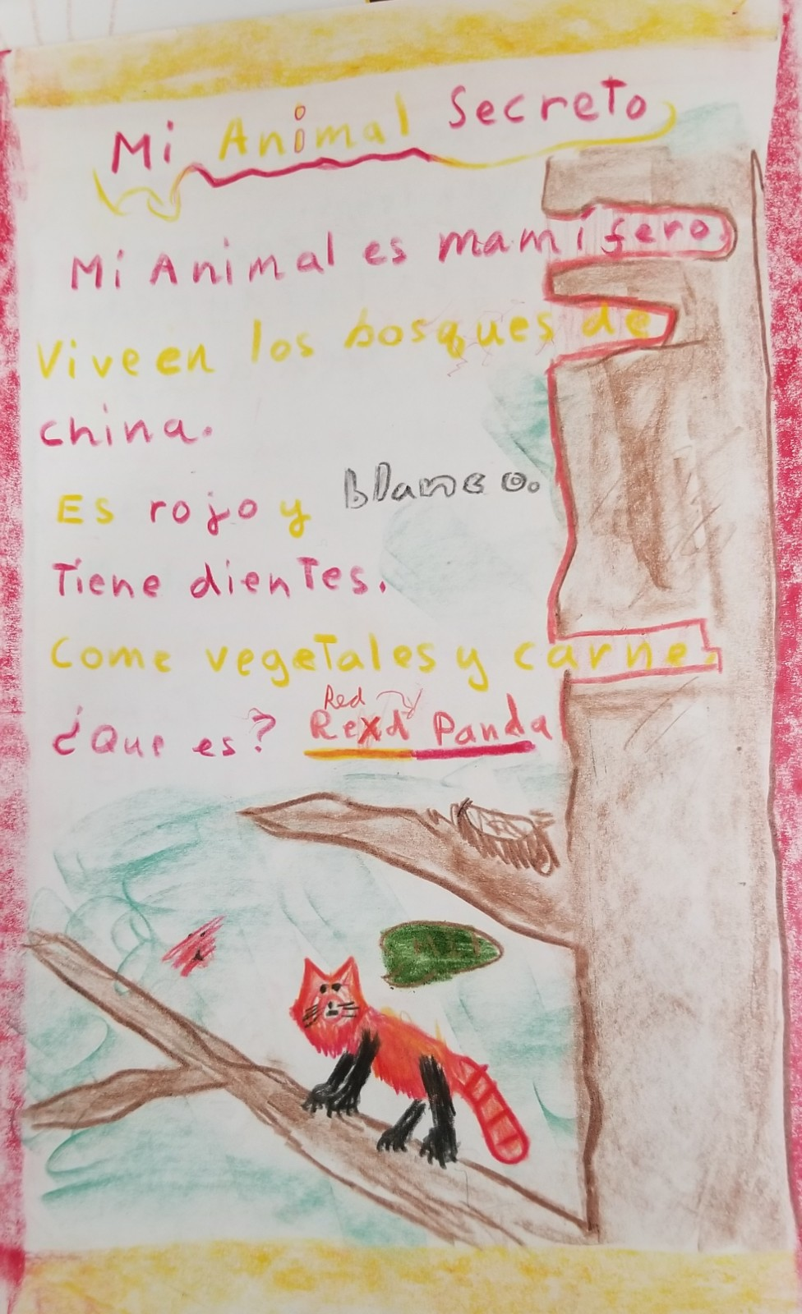
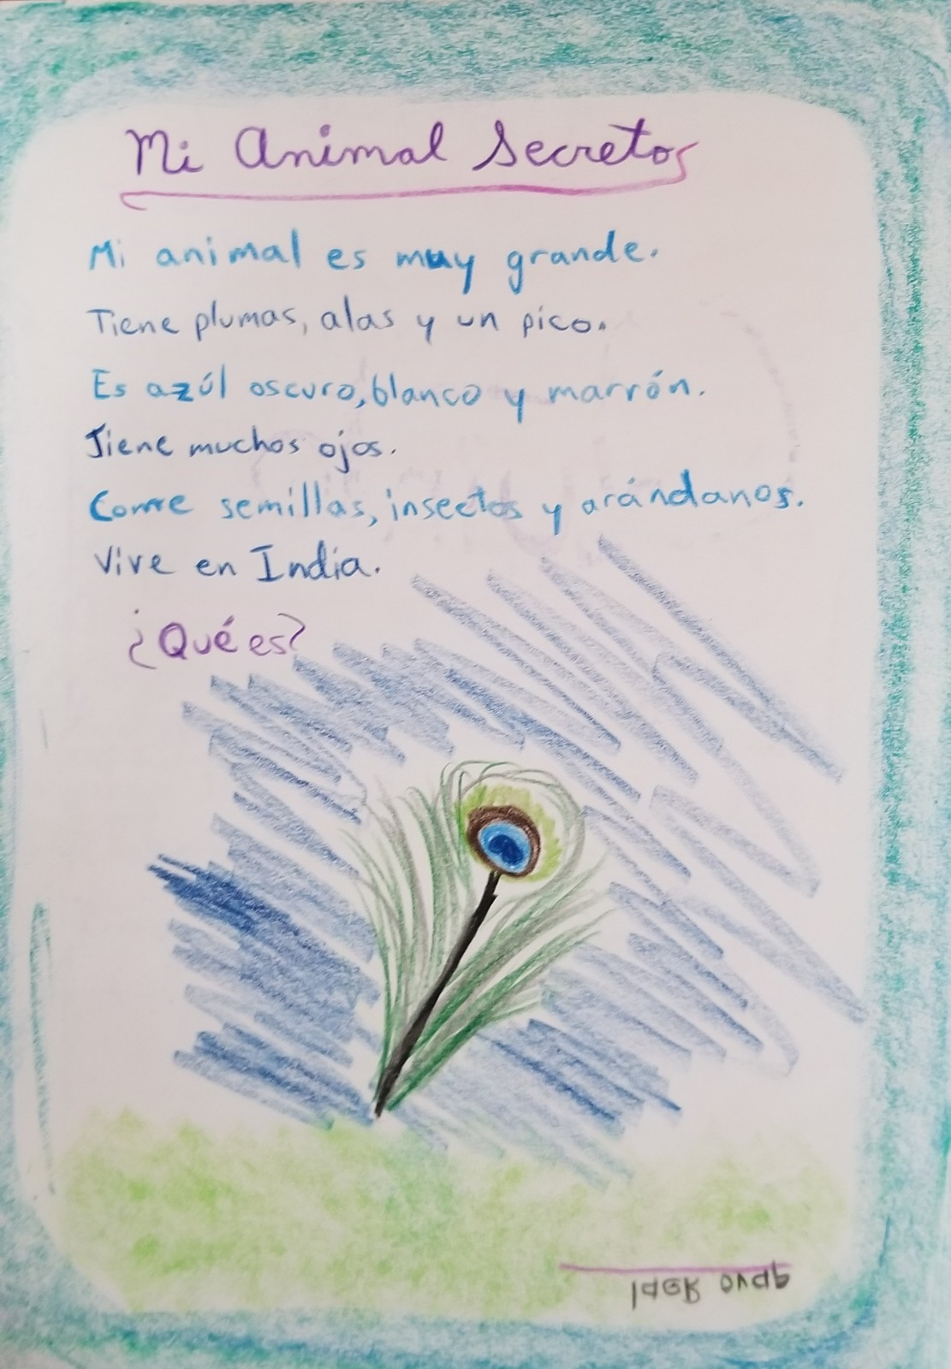
FOURTH GRADE:
Feeling: Animal riddles enjoyed during warm-up/ conversation
Thinking: Children guided through teacher example to create their own
Willing: Illustrate, Read out loud for classmates to guess

Slide 27
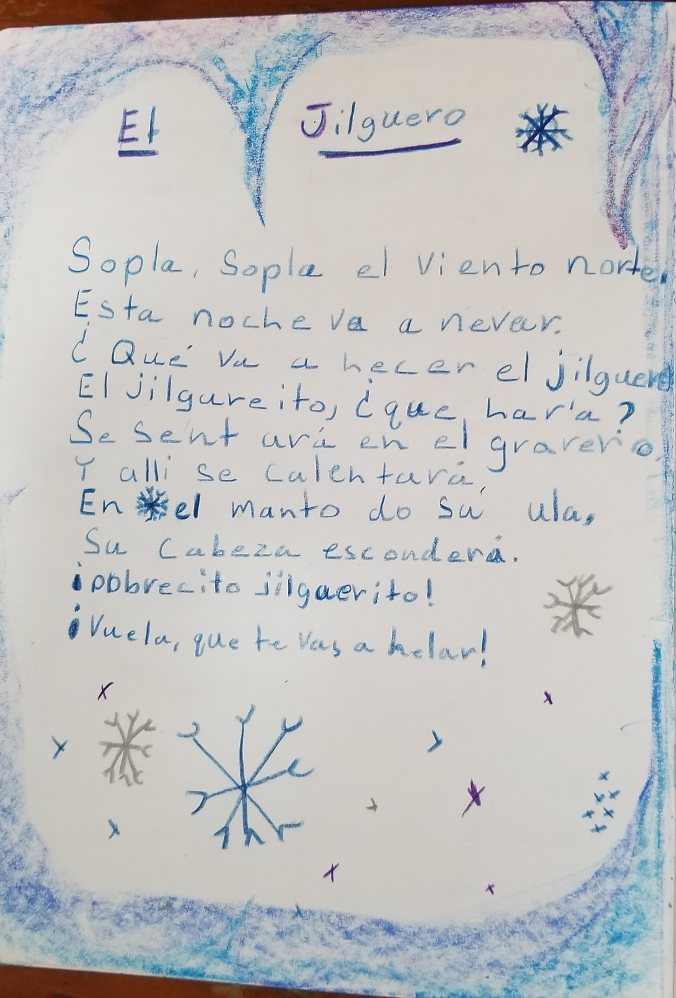
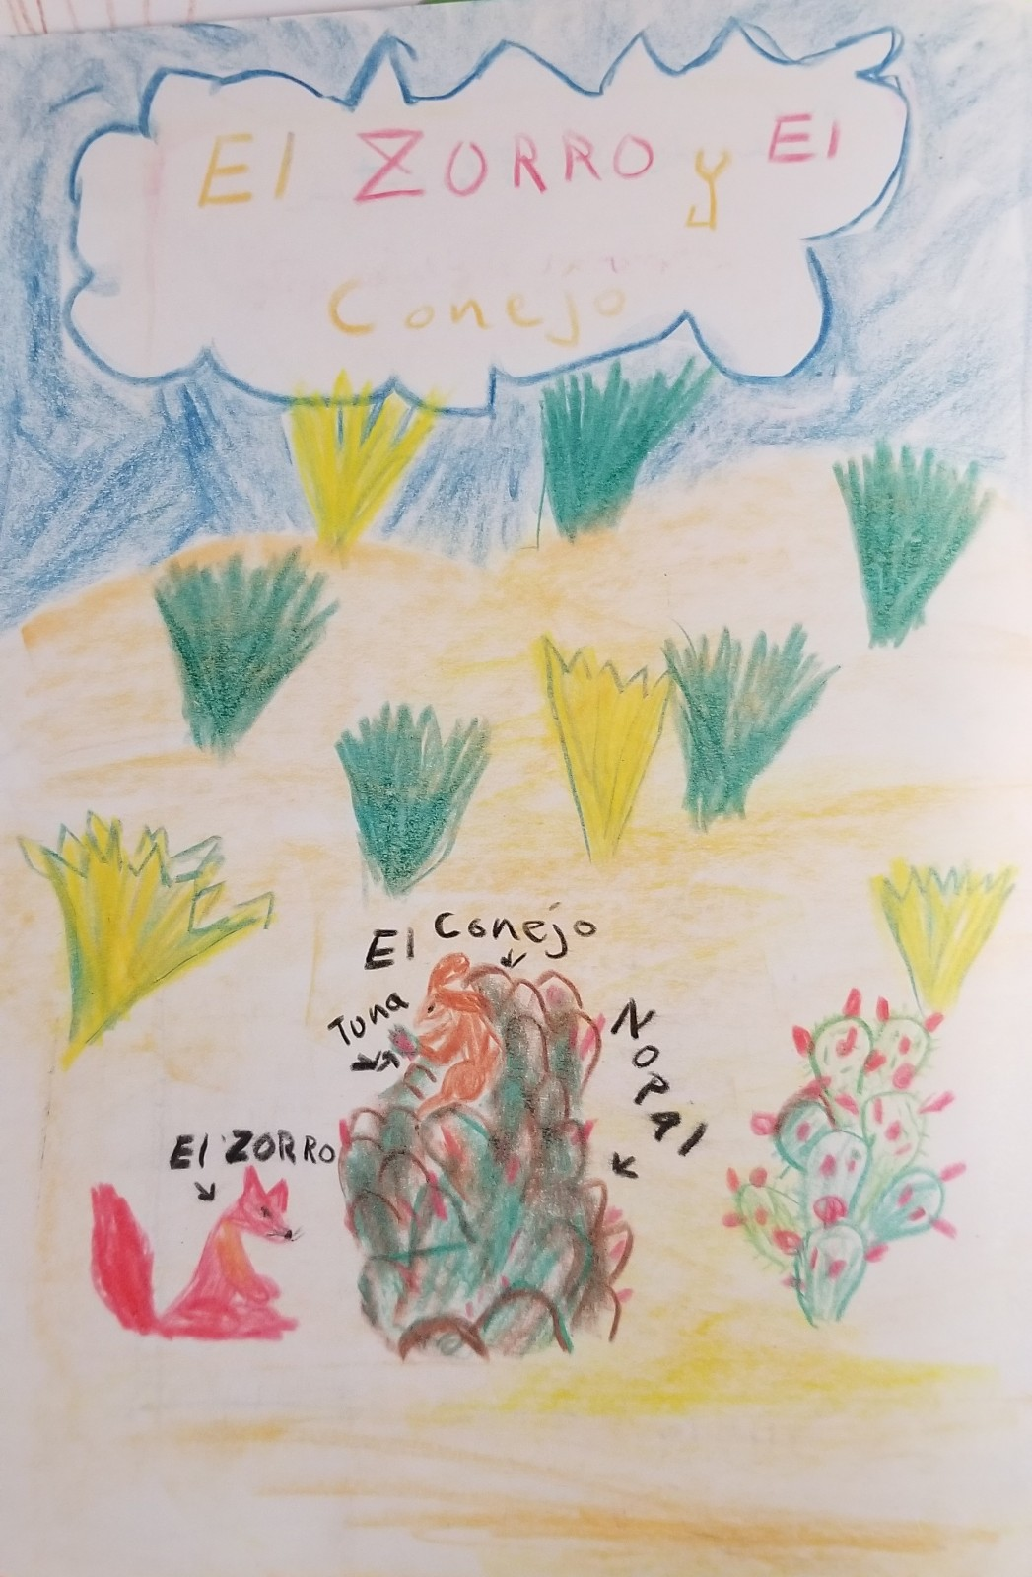
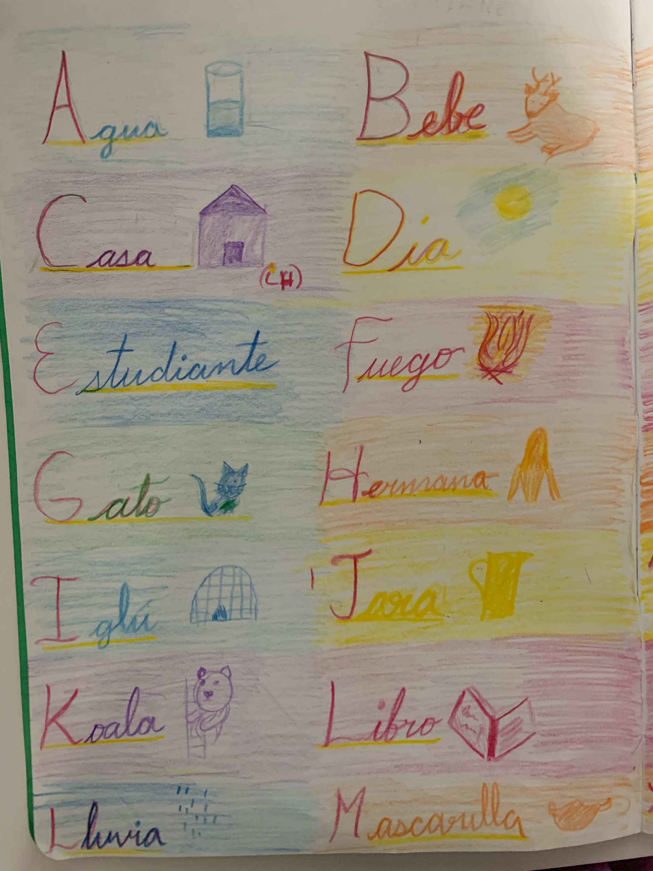
Feeling: Recite and memorize
Thinking: Practice reading fluency, Recognize nouns and verbs
Willing: Write and illustrate, act

Slide 28
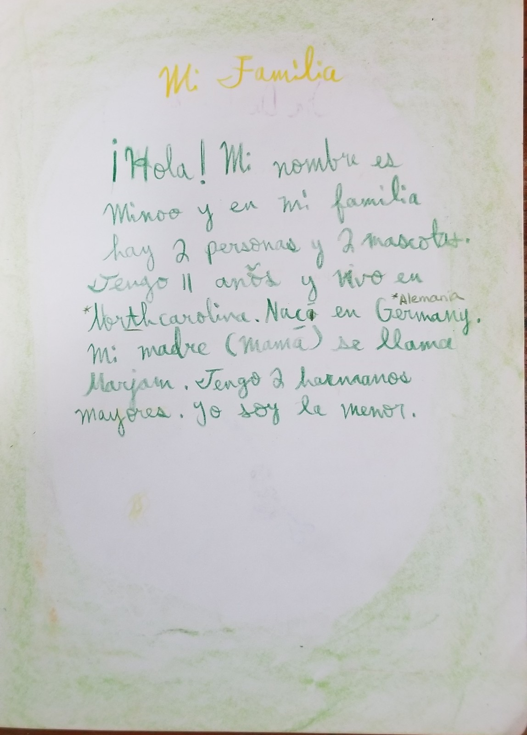
FIFTH GRADE:
Feeling: Sharing classmates’ biographies
Feeling/Thinking: Q&A using target vocabulary to make personal connection
Thinking/Willing: Each student writes an individualized paragraph
Feeling/Willing: Personalized illustrations, read out loud

Slide 29
Something Review
Something New
Something Just For Fun!

Slide 30
Who is WSTA?
Waldorf Spanish Teachers Association

Slide 31
Who is WSTA?
Waldorf Spanish Teachers Association
Founded in 2013
Resources, mentoring, seminars, conferences, evaluations of Spanish language teachers
Members of WSTA are committed to continual personal and professional development
Strive to create vibrant Spanish programs in their respective Waldorf schools, by following the indications of Rudolf Steiner in the curriculum.
https://waldorfspanishteachers.org/

Slide 32
Current Leadership Team of WSTA:
Diamela Wetzl
Ximena Sierra
Barbara Wauters
Maria Creamer
Kim Napa
Maria Cardenas
knapa@emersonwaldorf.org
https://waldorfspanishteachers.org

